Slide 1

AAI 510- Ethics in AI
HR Analytics - Employee Attrition & Performance
Agenda
01 Business Understanding
02 Dataset Understanding
Problem Statement & Objective
Dataset Description
03 Data Preparation
04 Modelling
Data Preparation
Model & Hyper-parameter Tuning
05 Evaluation
06
Model Evaluation
Conclusion
Presenter: (Group 12)
Sai Ramanan M K
Prasanna Gopalrathinam

Slide 2

Problem Statement
HR faces challenges in retaining top talent and optimizing employee performance.
Understanding the factors contributing to employee attrition is critical for HR strategy.
Key variables such as job role, satisfaction level, and work-life balance need deeper analysis.
Predictive modeling can help identify at-risk employees and improve retention efforts.
Data-driven insights will enable targeted interventions and enhance workforce productivity.
This project leverages machine learning and statistical analysis to support strategic HR decisions and create a more engaged, high-performing workforce.

Slide 3

Objective
Identify Key Attrition Drivers
Predict Employee Turnover
Analyze employee data to uncover factors—like job satisfaction, income, or role—that influence attrition, enabling early detection of patterns that lead to voluntary resignations.
Use classification models to forecast attrition risk, allowing HR teams to proactively address potential exits through tailored retention strategies and better employee engagement.
Evaluate Performance Correlations
Enhance Workforce Planning
Study relationships between employee performance and variables such as experience, work-life balance, and department to guide decisions around promotions, training, and organizational structure.
Leverage insights to optimize headcount, improve role fit, and ensure resource alignment across departments, supporting more efficient hiring and internal mobility decisions.

Slide 4
Dataset Description
Diversity of Data
Types of Features
Total Features
The dataset contains 1,470 employee records, capturing demographic, job-related, and satisfaction metrics across diverse departments and roles.
Target variable Attrition (Yes/No) reflects whether an employee left the company, enabling binary classification for predictive analysis.
It includes 35 features, combining categorical and numerical data types essential for evaluating employee behavior, tenure, and performance dynamics.
Most Important Factors
Data Use case
Variables like JobSatisfaction, WorkLifeBalance, and MonthlyIncome allow exploration of HR factors influencing retention and workforce engagement.
The data supports building machine learning models for identifying attrition risks and optimizing organizational planning and policy development.

Slide 5
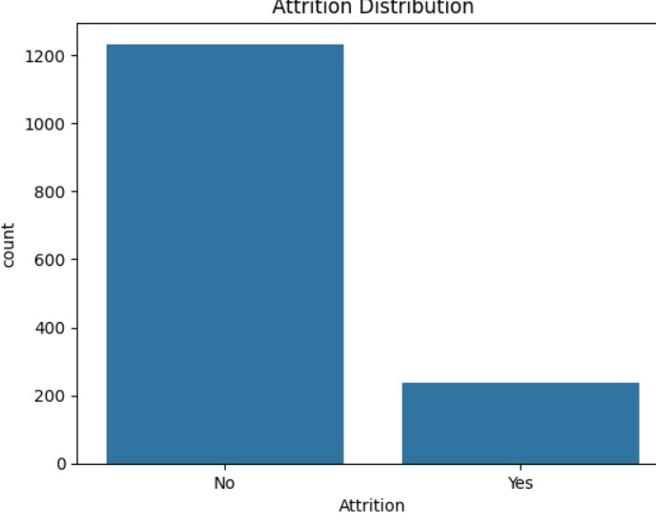
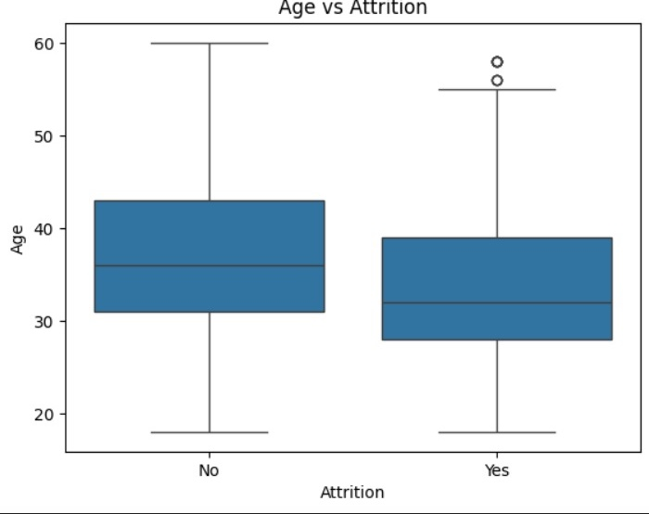
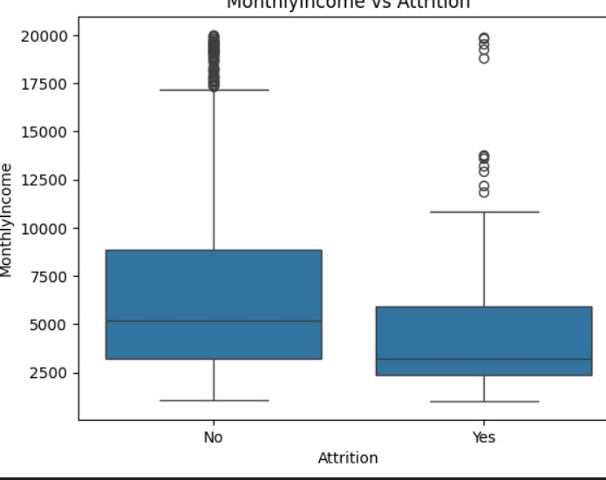
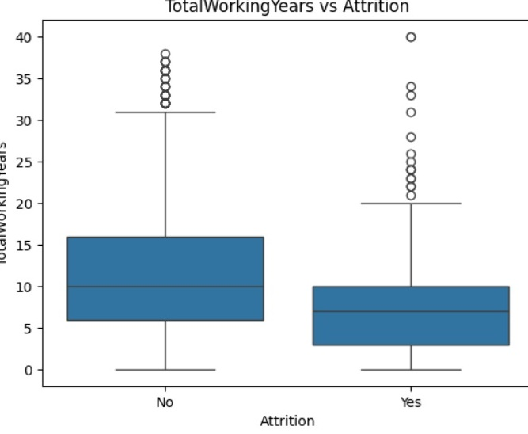
Exploratory Data Analysis
The dataset is imbalanced as the No. of records with Attrition “No” is far greater. This might lead to biased prediction. EDA is performed between the attributes
Age vs Attrition (Bar plot)
Monthly Income vs Attrition (Box Plot)
Distance from home vs Attrition (Box Plot)
Overtime vs Attrition (Bar plot)
Years At company vs Attrition (Box plot)
Total Working Years vs Attrition (Box Plot)

Slide 6
Data Preparation
Checking for Null Values
Label Encoding
The dataset contains no missing values, ensuring data integrity and simplifying preprocessing without the need for imputation techniques.
Binary columns are label-encoded—mapping ‘Male’/‘Female’, ‘Yes’/‘No’ values to 1s and 0s for efficient model input.
One hot Encoding
Feature Selection
Applied to multi-class categorical fields to convert text values into binary vectors, preserving category information without ordinal assumptions.
Non-informative fields like ‘EmployeeCount’, ‘Over18’, ‘StandardHours’, and unique identifier ‘EmployeeNumber’ were removed to avoid noise in modeling

Slide 7
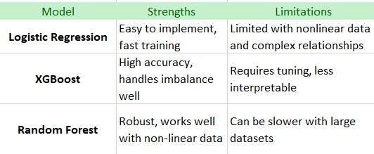
Model Selection
Logistic Regression
Simple, interpretable model effective for binary attrition prediction with limited feature interaction understanding.
XG Boost
Boosted decision tree algorithm capturing complex patterns and feature interactions for superior attrition prediction accuracy.
Random Forest Classifier
Ensemble of decision trees reducing overfitting, balancing accuracy and interpretability for employee attrition modeling.

Slide 8
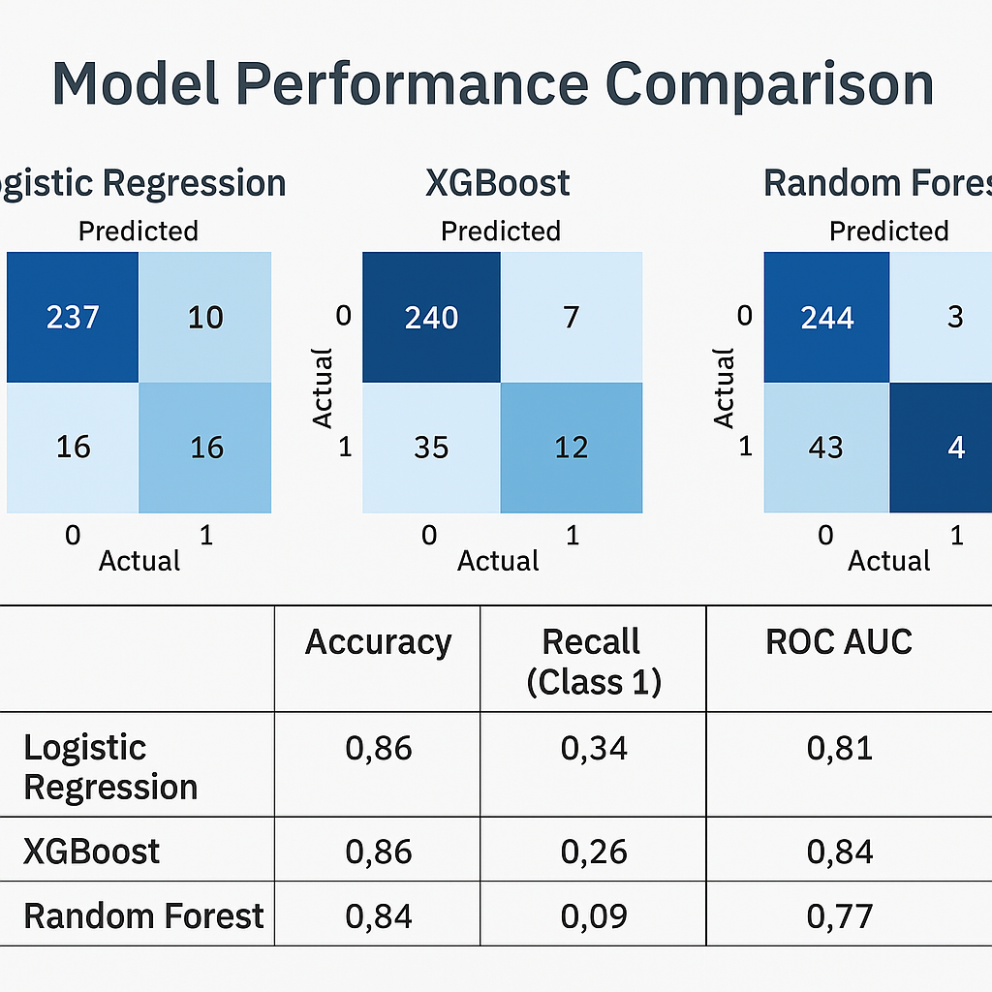
Model Evaluation
Logistic Regression delivers solid overall accuracy (86%) with a strong ROC AUC (0.81). It balances precision and recall reasonably, though recall for the attrition class is moderate (34%).
Random Forest achieves high accuracy for class 0 (non-attrition) but struggles significantly with class 1 (attrition), reflected in poor recall (9%) and a lower ROC AUC (0.77). It’s overfitting to the majority class.
XGBoost maintains the same overall accuracy (86%) as Logistic Regression, with better balance in detecting attrition (recall: 26%), and competitive ROC AUC (0.77). It's more nuanced at capturing complex patterns.

Slide 9
DEMO – Python Notebook

Slide 10

Conclusion
Model Comparison
Logistic Regression and XGBoost demonstrate strong predictive performance, achieving high accuracy with better recall for attrition. Random Forest underperforms in minority class detection, making it less effective for HR forecasting.
Business Impact
By leveraging predictive models on HR data, companies can proactively manage talent retention, reduce turnover costs, and foster a more engaged, high-performing workforce through informed, data-driven strategies.

